Slide 1
Z34Bio: A Framework for Analyzing Biological Computation
Boyan Yordanov, Christoph M. Wintersteiger, Youssef Hamadi, and Hillel Kugler
SMT 2013, Helsinki

Slide 2
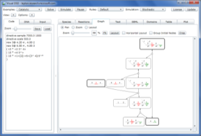
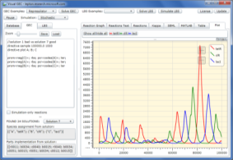
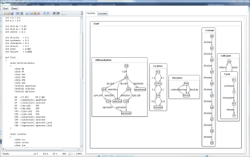
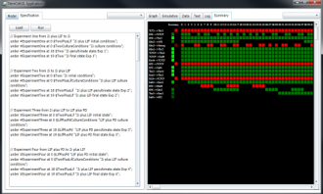
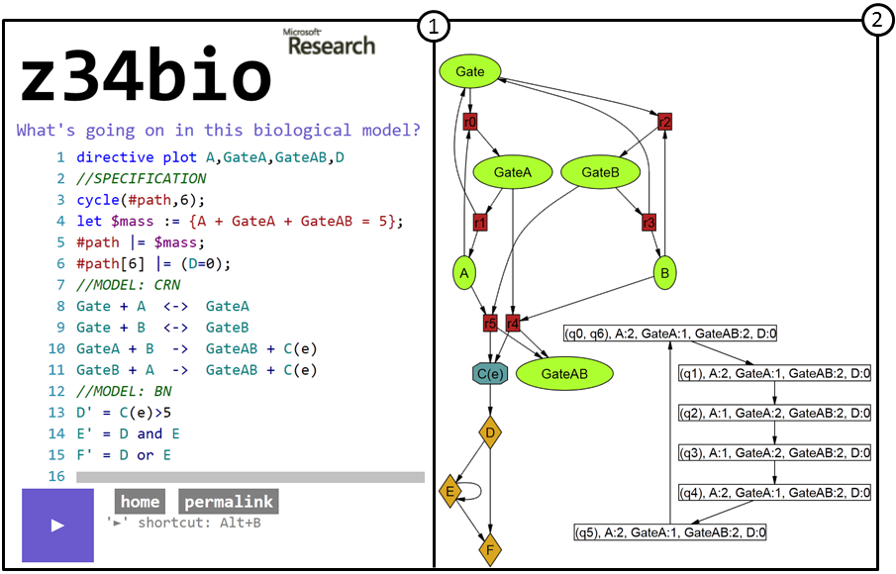

Exposing Biology to the Formal Methods Community and Vice Versa
DSD
GEC
Biocharts
Varna
…
Simulators
Biological Modelling Engine
Z34Bio
SMT
http://rise4fun.com/z34biology

Slide 3
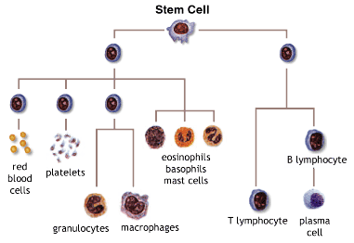
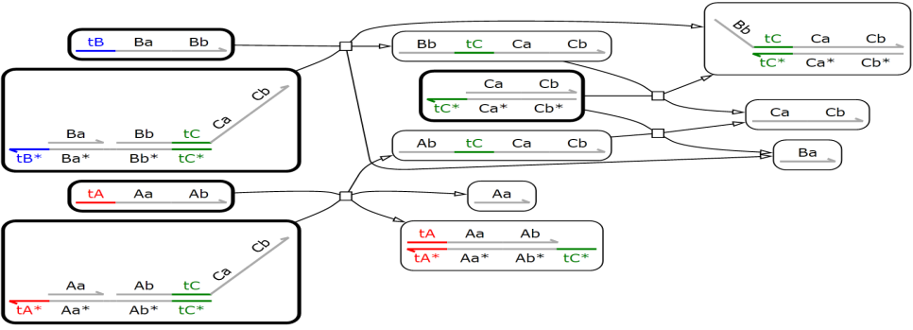

Questions that we cannot (fully) answer yet
ara
1
ara
NRI
4
pBad
NRI
pBad
glnAp₂
CI
LacI
NRI
2
6
ara
?
gfp
glnAp₂
gfp
Synthetic Biology – How to design biological systems with desired behavior from parts?
Stem Cells – what is a stem cell computing to maintain its state, and can we program stem cells to acquire specific fates in a robust way?
Developmental Biology – what are the design principles of organ development and maintenance?
DNA Computing – Is our designed circuit computing what we expected?

Slide 4
Boolean Networks
bool A, B, C;
while (true) {
A = f(A, B, C);
B = g(A, B, C);
C = h(A, B, C);
}
Boolean Functions

Slide 5
Boolean Networks
111
110
A
011
010
AND
C
OR
B
101
001
A,B,C
000
100

Slide 6
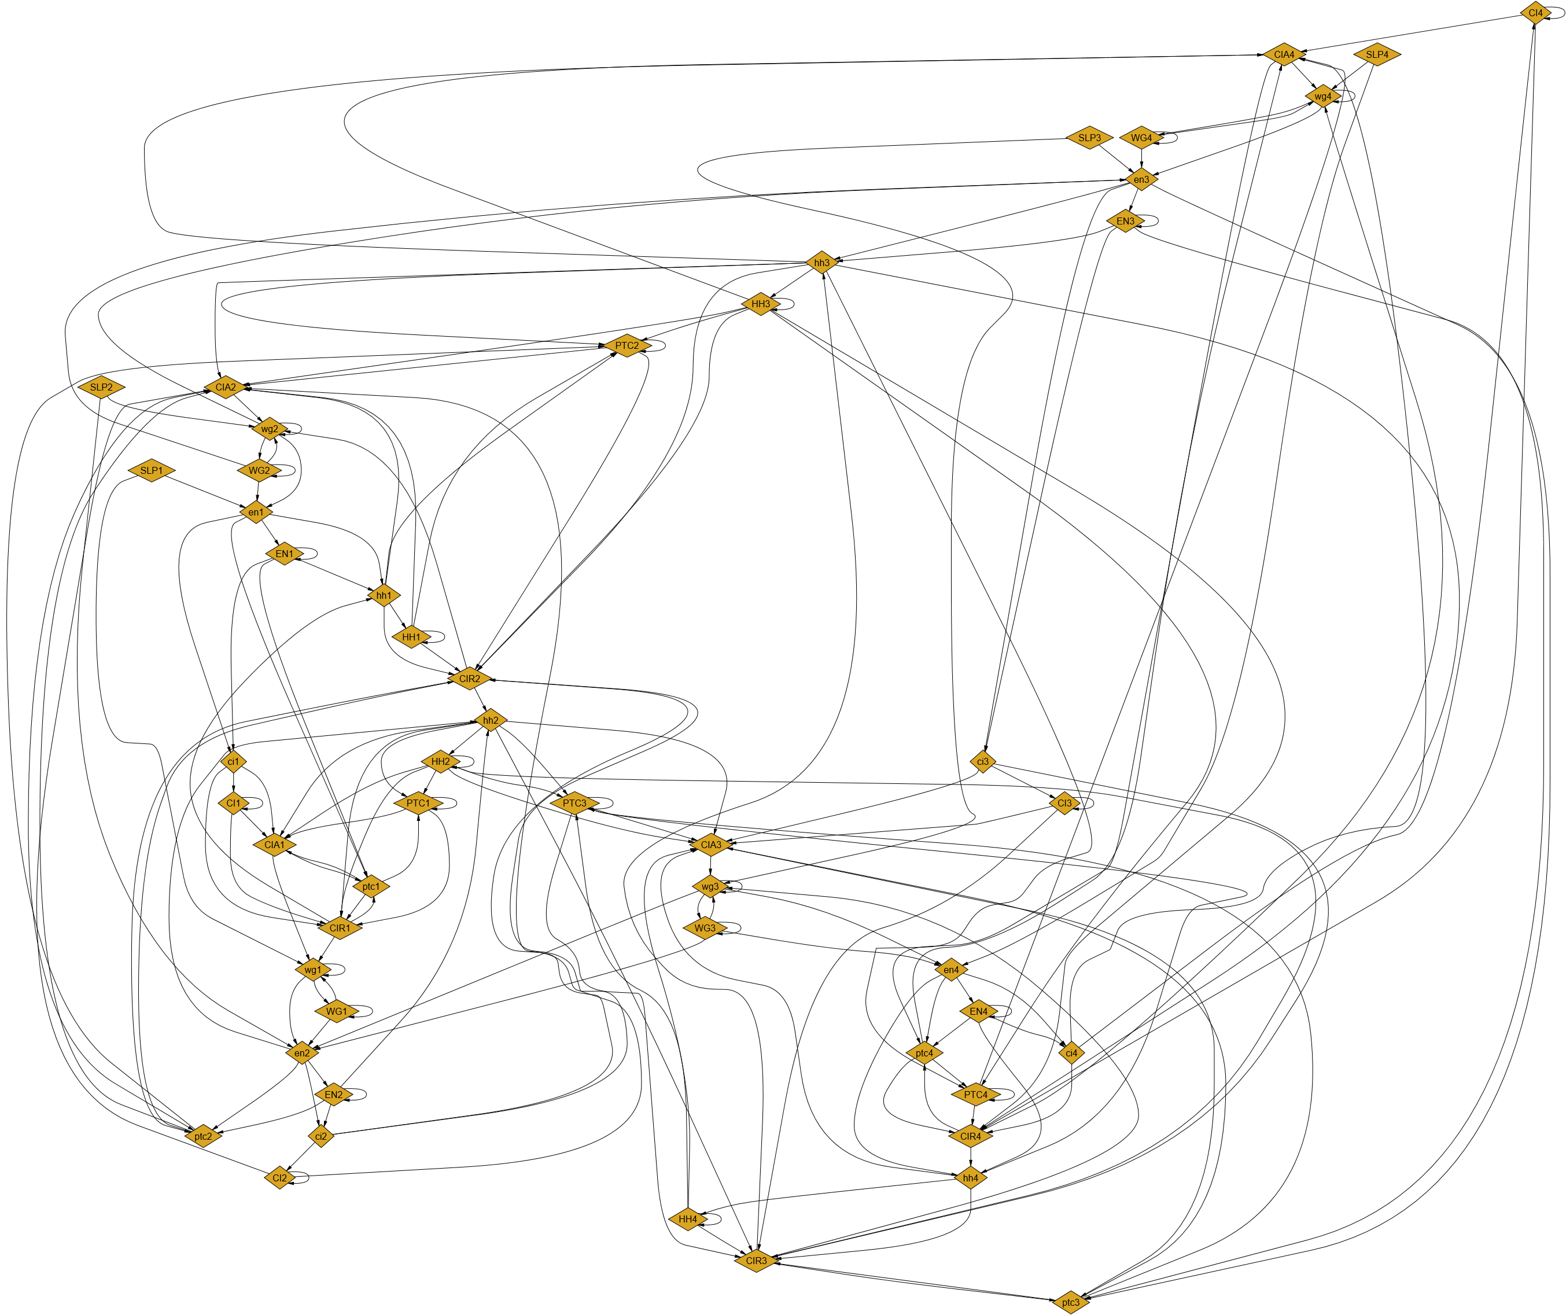
Drosophila melanogaster BN (Fruit Fly)

Slide 7
Chemical Reaction Networks
while (true) {
switch (*) {
2H + 1O -> 1H₂O
1C + 3O -> 1CO₂ + 1O
}
}
Reaction
Reactants
Products
Stoichiometry

Slide 8
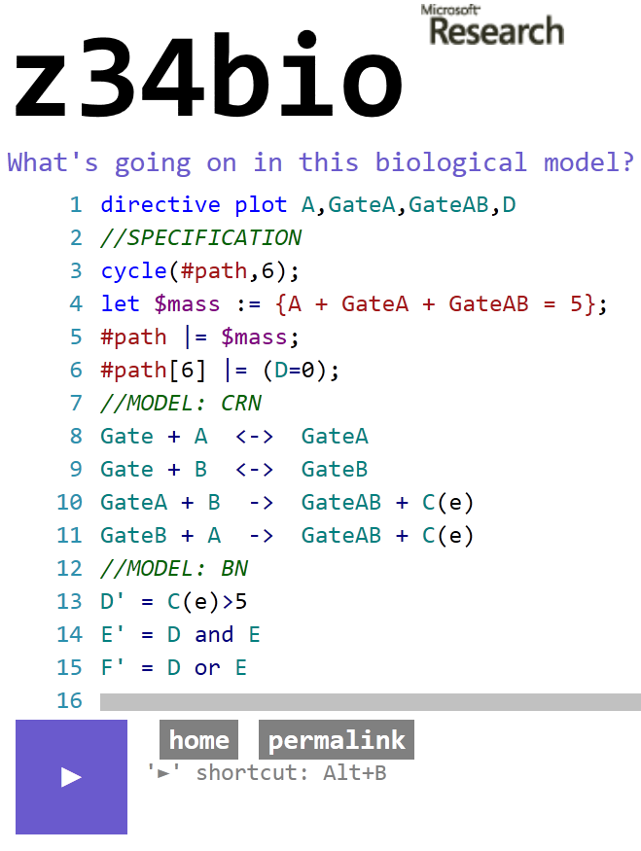
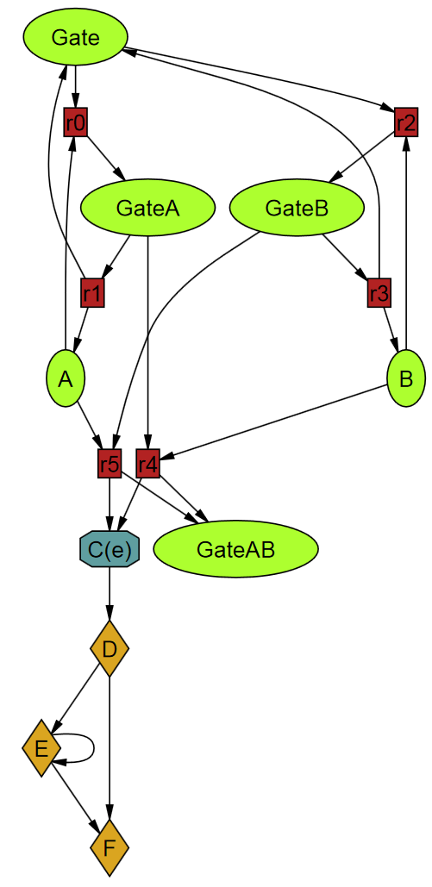
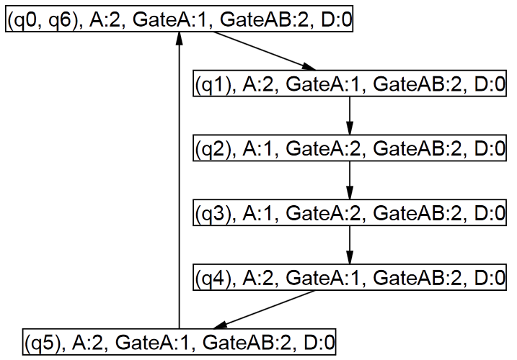
Combined Models
1
2

Slide 9
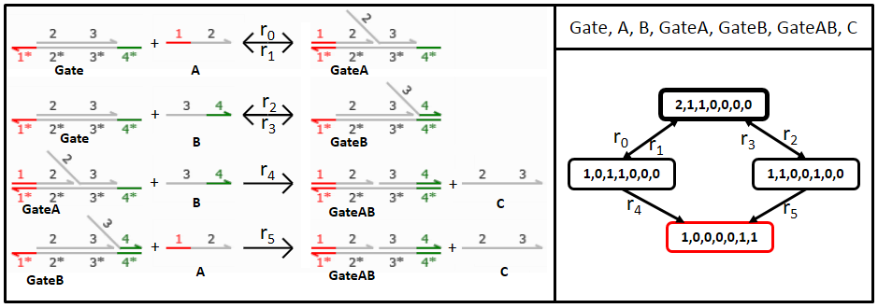
DNA Strand Displacement
DNA strand = large molecule
Different types of strands combine and displace

Slide 10


DNA Strand Displacement
Chemical reactions between DNA species
Complementarity of DNA domains
Example: DSD Logic Gate [Output = Input1 AND Input2]
Input 1
Input 2
Output
Substrate

Slide 11
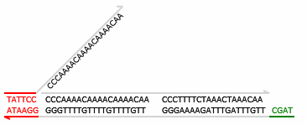
DNA Strand Displacement
Chemical reactions between DNA species
Complementarity of short/long DNA domains
Example: DSD Logic Gate [Output = Input1 AND Input2]
Input 2
Input 1
Output
Substrate

Slide 12
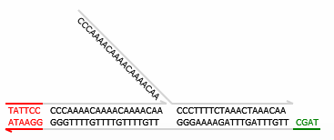
DNA Strand Displacement
Chemical reactions between DNA species
Complementarity of short/long DNA domains
Example: DSD Logic Gate [Output = Input1 AND Input2]
Input 2
Input 1
Output
Substrate

Slide 13
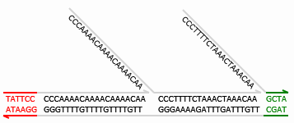
DNA Strand Displacement
Chemical reactions between DNA species
Complementarity of short/long DNA domains
Example: DSD Logic Gate [Output = Input1 AND Input2]
Input 1
Output
Input 2
Substrate

Slide 14

DNA Strand Displacement
Chemical reactions between DNA species
Complementarity of short/long DNA domains
Example: DSD Logic Gate [Output = Input1 AND Input2]
Output
Input 1
Input 2
Substrate

Slide 15
AND Gate in DNA

Slide 16


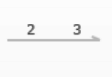

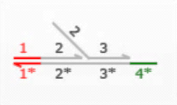


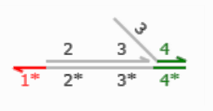







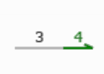
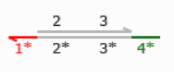
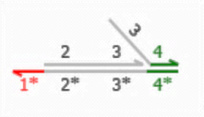
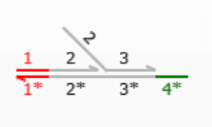
SMT Encoding
r₀
s₀
s₁
s₂
+
r₁
r₂
s₃
s₄
+
r₃
r₄
+
+
s₅
s₆
+
r₅
+
Set of species
Set of reactions
or
q'(s₀)=q(s₀)-1
q(s₀)
q‘’(s₀)=q(s₀)
q'(s₁)=q(s₁)
q(s₁)
q‘’(s₁)=q(s₁)-1
q'(s₃)=q(s₃)-1
r₀
q(s₃)
r₂
q‘’(s₃)=q(s₃)-1
q'(s₆)=q(s₆)
r₁
q(s₆)
r₃
q‘’(s₆)=q(s₆)+1
q’(s₄)=q’(s₄)+1
q(s₄)
q’’(s₄)=q’(s₄)
q'
q
q‘’

Slide 17
Abstractions and Approximations
Finite state space
Time (continuous vs. discrete)
Probabilities
Environment assumptions
Bounded analysis

Slide 18
Invariants
Laws of Physics, Chemistry, etc.
State invariants
Transition invariants
Especially: Mass Conservation
  E.g., DNA is not created out of thin air and does not vanish

Slide 19
Transducer
A
T
B

Slide 20
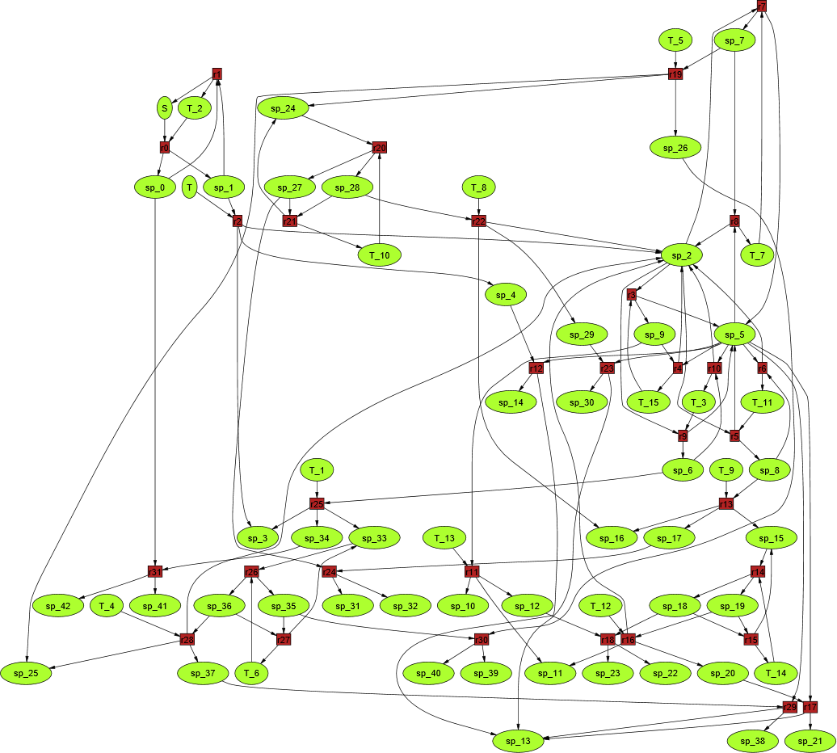
DNA Transducer CRN

Slide 21
Transducer Evaluation
Good Bad
(K=100)

Slide 22
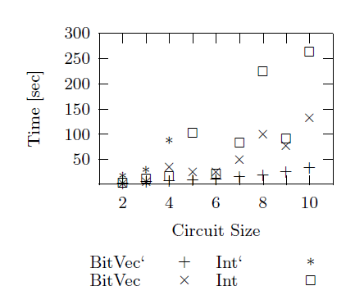
Correct Transducer Design
(K=100)

Slide 23
Challenges
Highly concurrent systems
Usually no long sequences like in software
Vast numbers of molecules (or atoms, strands, etc.)
(Often probabilistic)

Slide 24
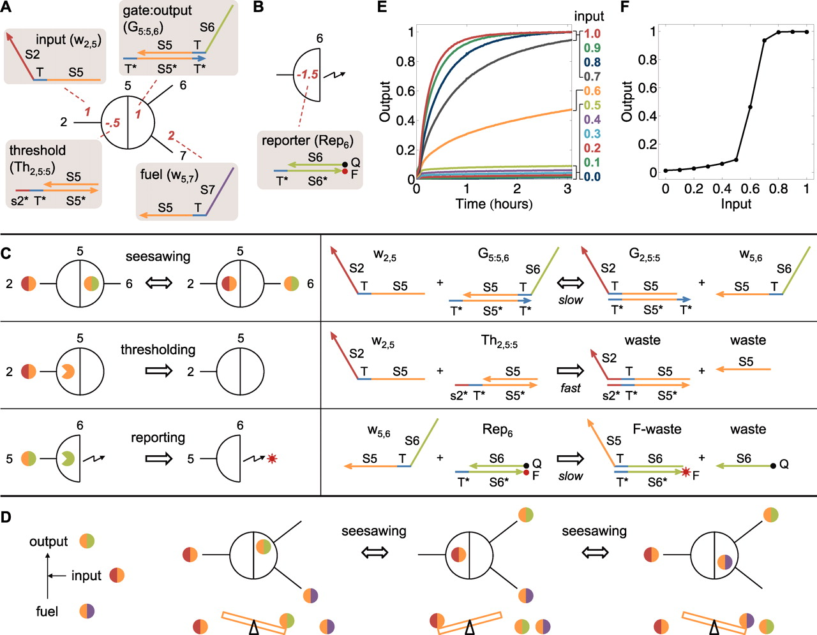
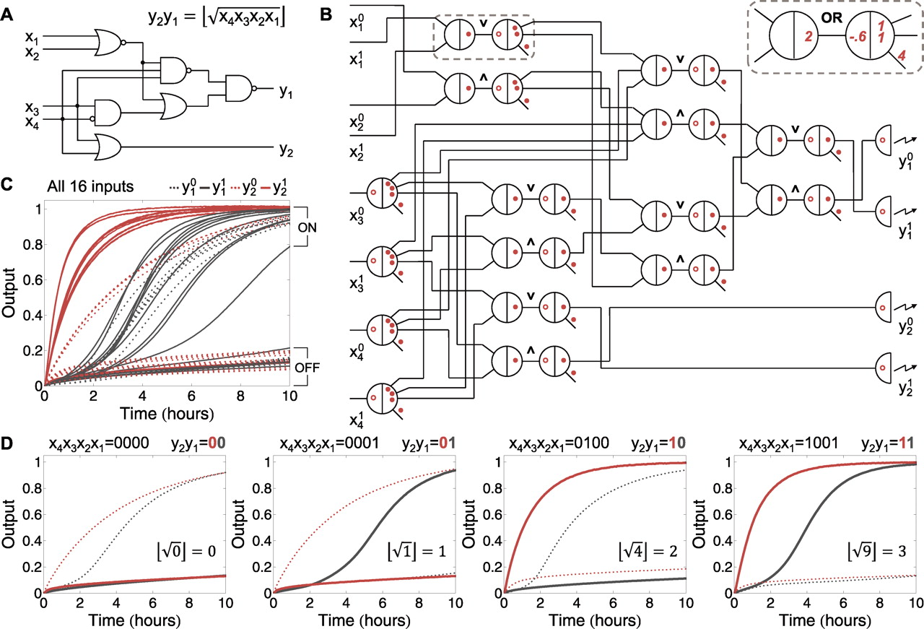
An example
L. Qian, E. Winfree: Scaling Up Digital Circuit Computation with DNA Strand Displacement Cascades, Science 332/6034, 2011.

Slide 25
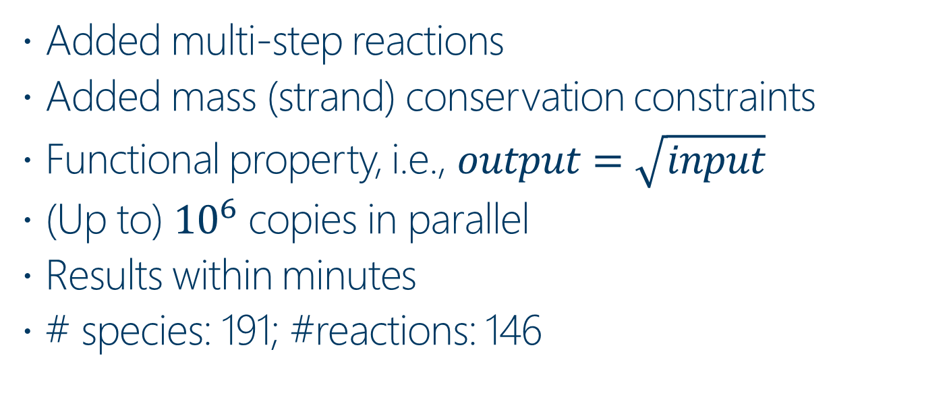
Analyzing the DNA Square Root Circuit
Added multi-step reactions
Added mass (strand) conservation constraints
Functional property, i.e., $output=\sqrt{input}$
(Up to) ${10}^{6}$ copies in parallel
Results within minutes
# species: 191; #reactions: 146

Slide 26
A Larger Example
# Reactions 7,440
# Metabolites 5,063
I. Thiele et al: A community-driven global reconstruction of human metabolism, Nature Biotech. 31/5, 2013.

Slide 27
A Larger Example
“We tested Recon 2 for self-consistency, a process that included gap analysis and leak tests”
I. Thiele et al: A community-driven global reconstruction of human metabolism, Nature Biotech. 31/5, 2013.
“We describe here the manual reconstruction process in detail”
[The COBRA] toolbox was extended to facilitate the reconstruction, debugging, and manual curation process described herein.
I. Thiele, B. Palsson: A protocol for generating a high-quality genome-scale metabolic reconstruction, Nature Protocols 5, 2010.

Slide 28
Conclusion
Computational Biology
  An auspicious new application domain
  SMT plays an important role
Z34Bio
  A framework and tool for analysis of various biological systems
  Current basis: CRNs and BNs
Future extensions
  Leverage more theories, e.g., Reals, Floats, Probabilities
  LTL/CTL-like properties
Benchmarks
  http://research.microsoft.com/z3-4biology

