Slide 1
SMT Solvers for Malware Unpacking
8 July 2013

Slide 2
Authors and thanks
Ian Blumenfeld
Roberta Faux
Paul Li
Work overseen by Mark Raugas – Director CyberPoint Labs
Special thanks to Levent Erkok for technical help with the SBV library
Notes:
Cyberpoint is a cybersecurity company, based in Baltimore.
We work in governement and commercial security.
CyberPoint Labs is the smaller research organization inside of the rest of the company.
Levent is awesome.

Slide 3
Malware analysis
We must understand the behavior of a piece of malware.
Obfuscation techniques make manual analysis time-consuming.
Skilled malware analyst time is expensive.

Slide 4
Binary packers
Transform a binary program into a new program that has the same functionality
Insert unpacking code that restores the original code in memory and then jumps to it
Use additional techniques to deter analysis
Range from freeware to expensive commercial products to custom packers written by malware authors
Notes:
Say: "What do Binary packers do?"
1. Mention encryption and compression in the classic case
2. Needs some way to get at the actual binary
3. Mention anti-VM and anti-debugger techniques here
4. Easy; hard; very, very hard

Slide 5
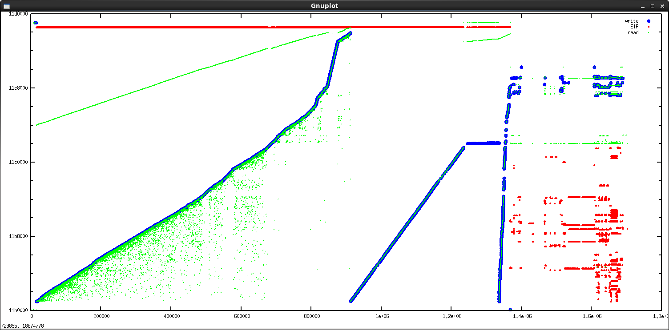
A simple packer: UPX
Notes:
Intel PIN-tool system to generate these graphs. We can automatically unpack UPX dynamically,
This is a trace of the action of a packed binary as it unpacks and executes.
x-axis = time
y-axis = memory address
Red is EIP (execution)
Blue is are memory write
Green is memory read
--
We can easily handle UPX

Slide 6
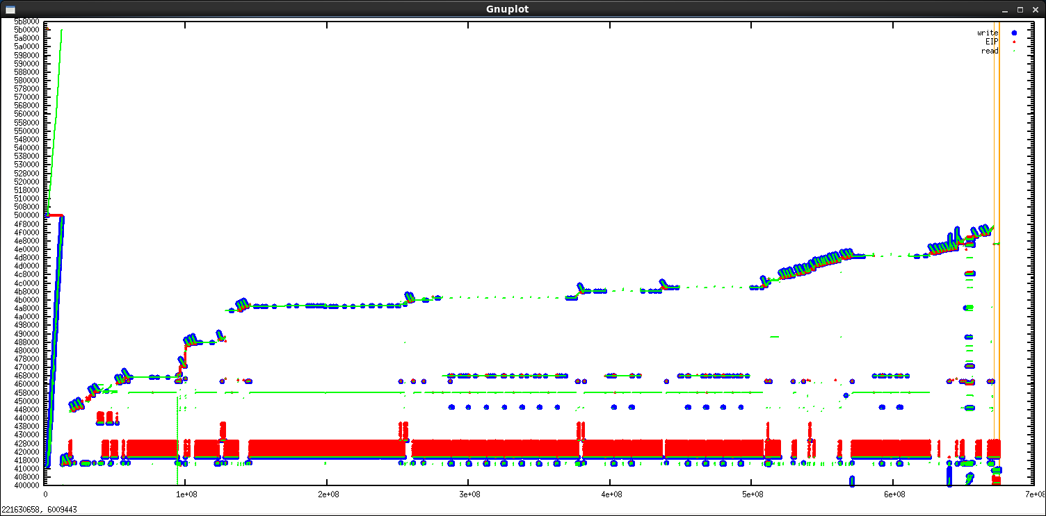
A harder packer: Themida
Notes:
Themida is a complicated commercial packer.
Note that we are skipping a whole of mid-range packers.
What on earth is going on here? This certainly isn't just compression or cryptography.
Red at botom is the VM.
VM performs unpacking operations.
Self-modifing code everywhere.
Bottom-right corner is the actual code, part of which is run through the VM.
API calls with stolen code present at vertical lines.

Slide 7
Virtualization
Themida embeds a virtual processor within the packed binary.
Certain instructions are converted to byte-code for that processor.
Each byte-code instruction is interpreted by a handler.
Even the handlers are obfuscated.
Different runs of the packer result in different handlers.

Slide 8
A (simple) handler
push dword 0x4a99
mov [esp],ebx
push esp
pop dword [esp]
push edx
mov edx,0x4
add [esp+0x4],edx
pop edx
push dword [esp]
pop edx
push edx
mov [esp],ebx
mov [esp],esi
mov [esp],ecx
mov ecx,esp
add ecx,0x4
push dword 0x504a
mov [esp],ebx
mov [esp],eax
push ecx
mov ecx,0x4
mov eax,ecx
mov ecx,[esp]
add esp,0x4
add ecx,eax
mov eax,[esp]
push esi
mov esi,esp
add esi,0x4
add esi,byte +0x4
xor esi,[esp]
xor [esp],esi
xor esi,[esp]
mov esp,[esp]
xchg ecx,[esp]
pop esp
Notes:
This is just “POP ESP”

Slide 9
Complications
Handlers may be much more complex than the example, and not end in the real instruction.
Some handlers run on byte-code encrypted with a special constant.
Obfuscation techniques for handlers may be random and handlers are repeated.
Notes:
Note that the opcode-to-handler mapping also changes each file. If there’s some way to increase entropy, Themida probably does it.

Slide 10
Symbolic simulation
CyberPoint has written a Haskell library to symbolically simulate handlers.
We use the open-source SBV library to provide a generic API to hook our code into SMT solvers.
  CVC4
  Z3
  Yices
  Boolector
We model our machine using bit-vector and uninterpreted function theories
We can use SMT to prove properties about the handler code.
Notes:
SBV stands for “SMT-Based Verification”
It is written and maintained by Levent Erkok, mentioned in the initial slide

Slide 11
Deobfuscating simple handlers
Compile a list of reference handlers:
  Homegrown rewriter
  Manual analysis
  Examples from the literature
Use trace tools to locate handlers in the virtual processor
Use symbolic simulation and SMT solver to try to prove equivalence of an isolated handler to each reference handler
Notes:
There were about 170 handlers in the virtual processor in our sample files

Slide 12
Results on simple handlers
On purely symbolic machine state identification takes 5 minutes.
By intelligently concretizing certain values to reduce to candidates, simpler handlers can be identified in about 5 seconds.
These numbers make use of the embarrassingly parallel nature of the problem.
Results without parallelization in the following chart:

Slide 13
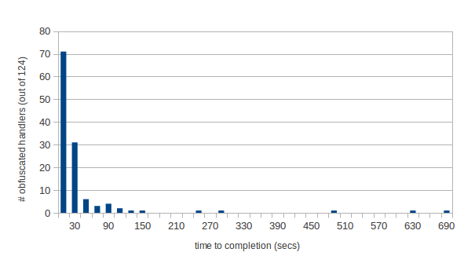
Results table for simple handlers
Notes:
89% success rate on handlers without bytecode obfuscation

Slide 14
Obfuscation constants
Constants are used to “encrypt” using a variety of patterns
Patterns are determined by by trying prove possible equivalence on the “state” register EBX
Once pattern is obtained, can use SMT for function inversion to discover the constant
Preliminary success in simple handlers that use constants, though all constants recovered so far can also be found through other means
Notes:
Mention that the constant is possibly used with some arithmetic as offsets into memory
Works because we’re not working with real strong encryption like AES, but rather invertible arithmetic operations
Arithmetic is simple. Bit-blasting works. Could do better than some other methods of the packers start using more compicated operations that are reflected in different SMT theories.

Slide 15
Constants to encrypt the bytecode stream
dispatch:
lodsb ; loads the next byte into AL,
; then advances the bytecode pointer ESI
add al, bl ; bytecode obfuscation
xor al, 0xe8 ;
add al, 0x47 ;
sub bl, al ;
movzx eax, al ; zero-extend the handler index
jmp [edi+eax*4] ; jump to handler
; in most cases the end of the
; handler jumps back to "dispatch"
Notes:
Note that this handler will actually appear obfuscated.
The obfuscation “pattern” (in this case add, xor, add, sub) and the obfuscation bytes (0xe8, 0x47) must be diagnosed

Slide 16
Stolen code
Understanding which API calls are made is critical information for a malware analyst.
Sometimes the packer will “steal” the first several instructions from an API function. It:
  Obfuscates them
  Inserts them into the caller
  Eventually jumps to an address to get it back to the API function
Wastes analyst time on a normally simple part of their task
Notes:
Mention memory reads, keystroke loggers, access ports to call home, etc.
The stolen code will follow the execute the same jump as the API function, causing it to get back “on cut”. From there it should folow the same path as the API call. Also possible that it just runs the whole thing and ends with the same return.
Restate that skilled malware analysts are rare and expensive

Slide 17
Stolen code example: original API function
;; kernel32!InterlockedIncrement
776fc3b0: 8bff mov edi, edi
776fc3b2: 55 push ebp
776fc3b3: 8bec mov ebp, esp
776fc3b5: 5d pop ebp
776fc3b6: eb88 jmp 0x776fc340
. .
. .
. .

Slide 18
Stolen code example: obfuscation in the caller
10a00000: 8bff mov edi, edi
10a00011: 95 xchg ebp, eax
10a00012: 50 push eax
10a00013: 52 push edx
10a00029: 0f31 rdtsc
10a0002b: 60 pushad
10a0002c: 8bca mov ecx, edx
10a0002e: 50 push eax
10a0002f: 52 push edx
10a00030: 0f31 rdtsc
10a00032: 5a pop edx
10a00033: 58 pop eax
10a00034: 61 popad
10a00035: 5a pop edx
10a00036: 58 pop eax
10a00037: 50 push eax
10a00038: 50 push eax
10a00039: 52 push edx
10a0004f: 0f31 rdtsc
10a00062: 5a pop edx
10a00063: 58 pop eax
10a00064: 95 xchg ebp, eax
10a00073: 8bec mov ebp, esp
10a00075: 50 push eax
10a00076: 52 push edx
10a00077: 60 pushad
10a00078: 66bb707c mov bx, 0x7c70
10a0007c: e814000000 call 0x10a00095
10a00095: 58 pop eax
10a00096: 61 popad
10a00097: 0f31 rdtsc
10a00099: 60 pushad
10a0009a: 50 push eax
10a0009b: 5f pop edi
10a0009c: 0fb7cb movzx ecx, bx
10a0009f: 61 popad
10a000a0: 5a pop edx
10a000a1: 58 pop eax
10a000a2: 5d pop ebp
10a000a3: 60 pushad
10a000a4: 8bc7 mov eax, edi
10a000a6: 9c pushfd
10a000b4: 80dc56 sbb ah, 0x56
10a000c8: 9d popfd
10a000c9: 61 popad
10a000ca: e9e7c2cf66 jmp 0x776fc3b6
Notes:
Note the jump at the end to the same place.
The first instruction is identical too, but that’s just coincidence.

Slide 19
Results on stolen code
If we know a priori which code is stolen, we can loop over possible API functions to prove equivalence
For full generality, we would need to figure out how many instructions from the API calls are stolen
Proofs do work, but limited advantages over other techniques
Symbolic termination can be a problem

Slide 20
Comparisons to prior work
Work by Rolles in 2012 suggests using syntactic optimization techniques to undo obfuscation, then using SMT solvers to check the correctness of the optimization.
Our research shows that it is possible to remove the need for a syntactic optimizer. The SMT solver itself can do those tasks, albeit much slower.
There are potential advantages to an SMT only based approach, especially if more complicated obfuscation techniques are employed.

Slide 21
Moving forward
Given the initial successes, we should do real comparisons of SMT based approaches with others?
Can we use our work to actually rewrite the binary to a deobfuscated form?
How can we expand the work on Themida to other packers:
  VMProtect
  Enigma
  Custom packers
What other role can SMT solvers play in the world of malware analysis?
Notes:
For example, is the proof worth it in this context, or is showing it works for test vectors good enough?
Ideally no human interaction, or with an intuitive interface for the malware analyst
Custom packers are where there real problems are
I think quite a lot

Slide 22
Questions?

Slide 23
Thank you,
have a great day!

Slide 24


